Slide 1
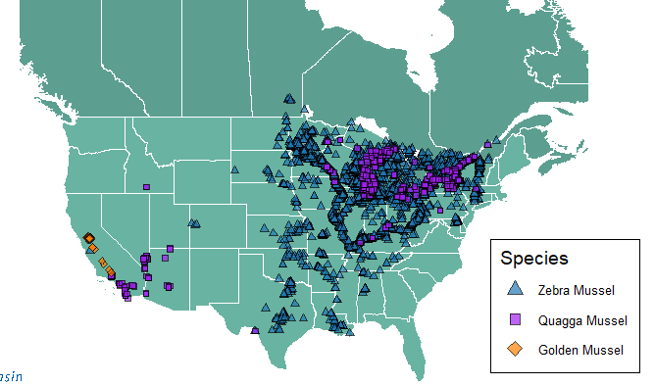

INVASIVE MUSSEL SIGHTINGS 1988 -2024
Data from the USGS
Graphics by OBWB

